Slide 1
Part 2: A classification task in CMR
SCMR Series of Hands-on Workshops on Machine Learning
Olivier Jaubert
Research Fellow in MR Physics and Machine Learning
Centre for Translational Cardiovascular Imaging
UCL Institute of Cardiovascular Science
o.jaubert@ucl.ac.uk

Slide 2

License
This work is licensed under a Creative Commons Attribution 4.0 International License.
You are free to:
Share — Copy and redistribute the material in any medium or format.
Adapt — Remix, transform, and build upon the material for any purpose, even commercially.
Under the following terms:
Attribution — You must give appropriate credit, provide a link to the license, and indicate if changes were made. You may do so in any reasonable manner, but not in any way that suggests the licensor endorses you or your use.
No additional restrictions — You may not apply legal terms or technological measures that legally restrict others from doing anything the license permits.
© 2022 Javier Montalt-Tordera. Some Rights Reserved.

Slide 3
Contents
Introduction
Improving generalizability and performance
Applications in CMR

Slide 4
Introduction

Slide 5
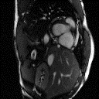
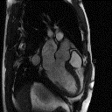
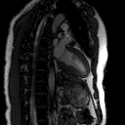
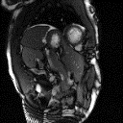
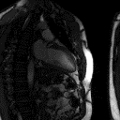
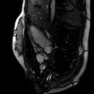
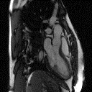
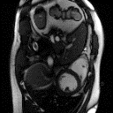
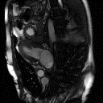
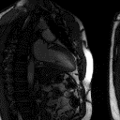
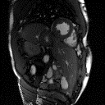
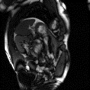
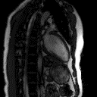
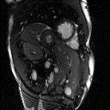
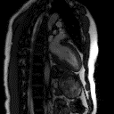

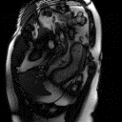
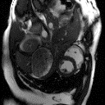
Classifying orientation
Notes:
As an exemple task for image classification in the previous class we proposed to classify the images’ orientation wether it was SAX or not.

Slide 6

Data preparation
Organising/Formatting/Data normalization
Organised Preprocessed Dataset
All patients
Training
60 %
Validation
20 %
Test
20 %
Training
SAX
Training
Non SAX
Val
SAX
Val
Non SAX
Test
SAX
Test
Non SAX
Notes:
Once the dataset is organised, we split the data into a training set, Validation set and Test Set.
The dataset is split to provide balanced numbers of SAX and non SAX,
Have enough exemples of each case to learn the task and evaluate the network.

Slide 7
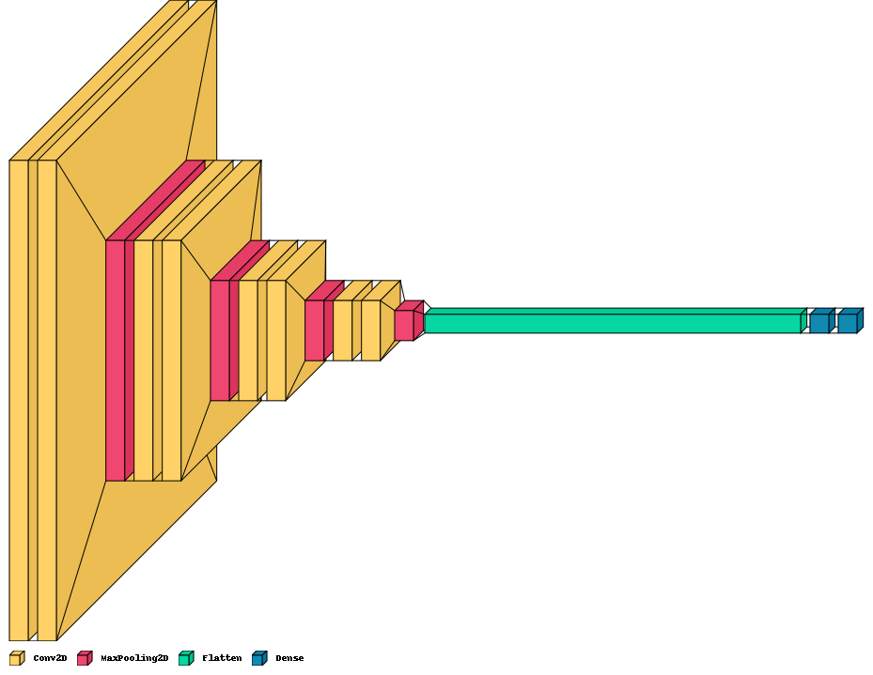
Classifier
Feature extraction
higher resolution
higher level semantics
sigmoid activation
Short axis ?
Yes/No
Notes:
We built our Neural network with a typical architecture for classification with a cascade of convolution and maxpooling for feature extraction and Dense layers to combine the information. Finally the sigmoid activation provides us the probability of our image of being short axis or not.

Slide 8
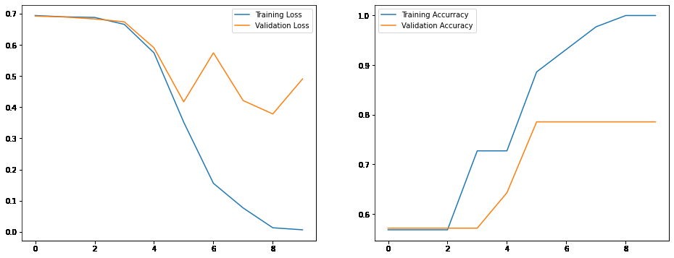
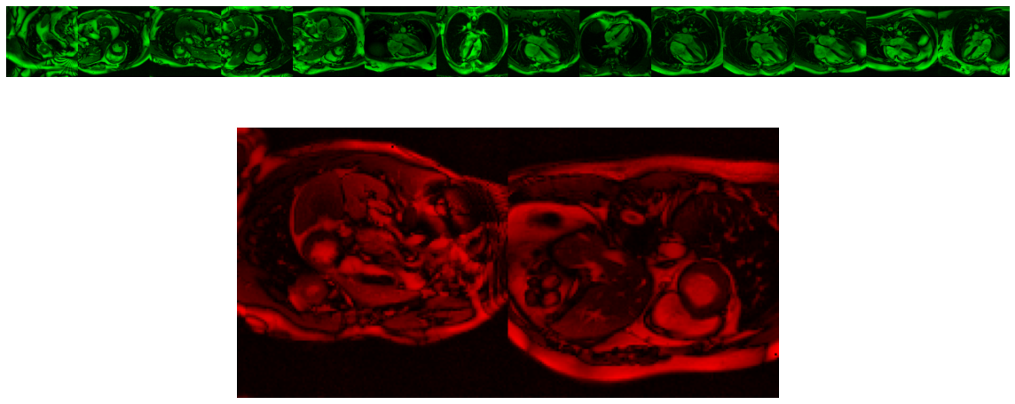
Evaluation
Training Accuracy: 1.0000
Validation Accuracy: 0.7857
Test Accuracy: 0.8750
Overfitting
The performance on the training set is largely superior to validation data
Notes:
We then proceeded to evaluate the model. The model presented perfect accuracy in the training set, and decent accuracy in the validation and test sets.
However we could already spot the inconsistency between the performance in the training and other sets in terms of loss and accuracy.
We call this inconsistency overfitting and we will look into what it is and strategies to reduce this overfitting and get a model which generalizes better to unseen data.
So basically we can go to our hands-on code and run what we had done so far and this will be our starting point for this session.
https://colab.research.google.com/github/mrphys/MLinCHD_Workshop/blob/master/Workshop3/Exercises.ipynb#

Slide 9
Improving generalizability and performance

Slide 10
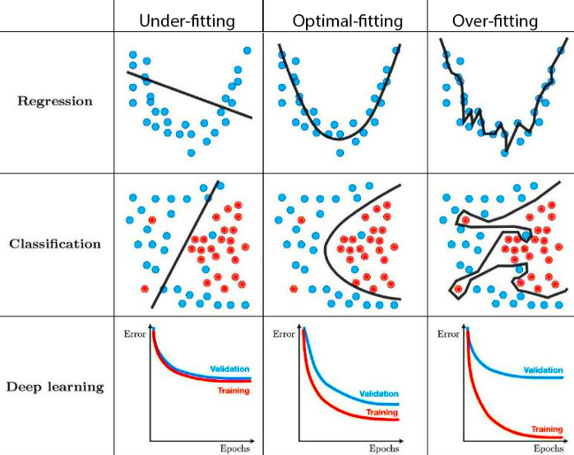
What is overfitting ?
Notes:
So what is overfitting
We show here typical cases of underfitting, near ideal fitting and clear over fitting.
In the case of underfitting you would get sub optimal performance for both training and validation,
while with overfitting suboptimal performance on validation data and overly optimistic performance on the training set.
As you can see although the overfitting would provide very low loss on the training data (for exemple split the training data perfectly, even taking those two outliers), it will very poorly generalize to new data. (a point here would more probably be blue than red).
In between the two is a sweet spot with good training and validation performance
The aim is then to get the best model which can perform and generalize well to data the network has not seen yet.
One of the points of overfitting is that it does not capture the characteristics you were aiming for.

Slide 11
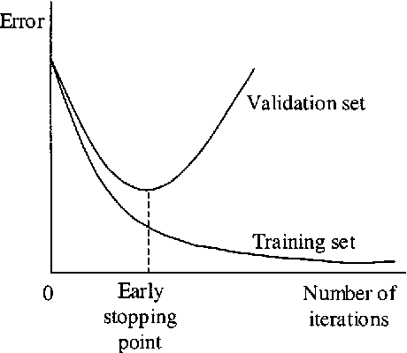
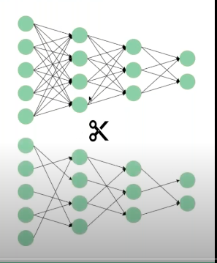
Preventing overfitting
- Ideally more data
- Changes in the model architecture
(number of layers/features/implicit encoding, etc)
- Data pre-processing/normalization
- Early stopping
- Drop out
- Regularization
- Data augmentation
SAX
SAX
SAX
Notes:
There has been a lot of proposed ways to reduce overfitting.
Ideally you would have just a very large number of data points which would lead to overall accurate.
However you usually have a limited amount of data especially in medical imaging applications and this leads to other strategies being used such as
Changes in model architecture (simplifying the model will usually help reduce overfitting)
But what we will actually do here is with a fixed dataset and architecture try:
Data normalization
Early stopping
Drop Out
Weight Regularization
And Data augmentation
Which are commonly used to tackle this problem.

Slide 12
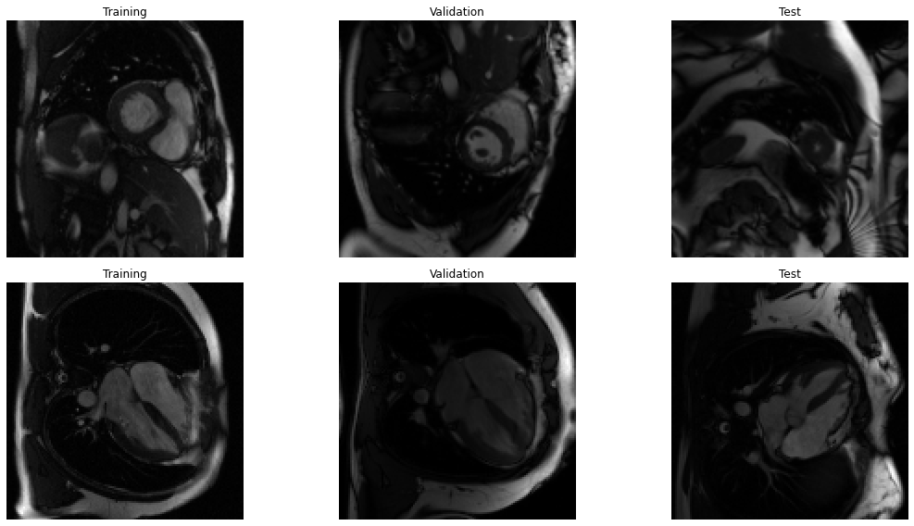
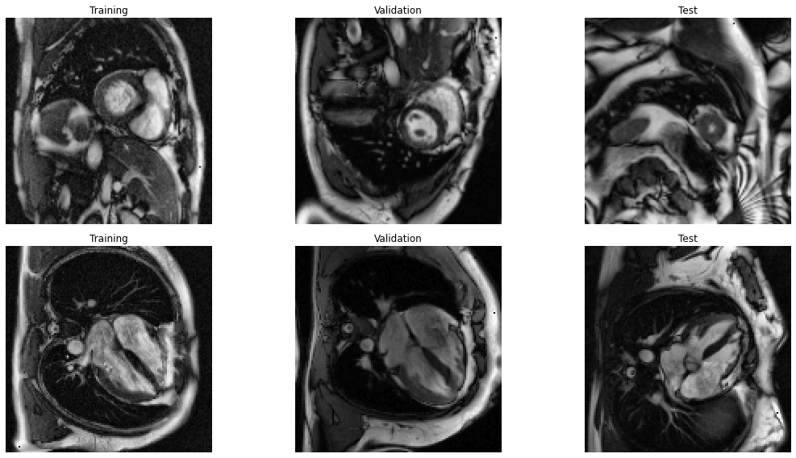
Data Normalization
Original data
Normalized data
Without preprocessing
CLAHE
Pre-processed
Notes:
Data normalization is a way to simplify the task of the network to some extent.
It can be challenging for the network to achieve perfect separation in the first case and sometimes it is trivial given appropriate pre-processing.
In our case the original data has some pseudo random contrast which can affect the classification.
We therefore use a contrast normalization step on each image to hopefully help the network focus more on shape than contrast.

Slide 13
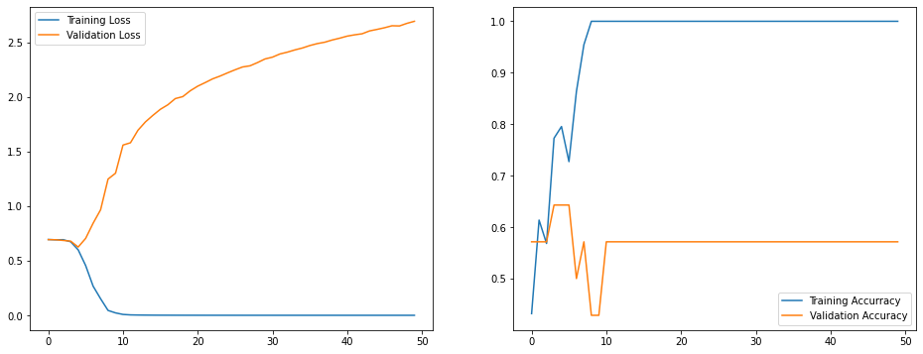
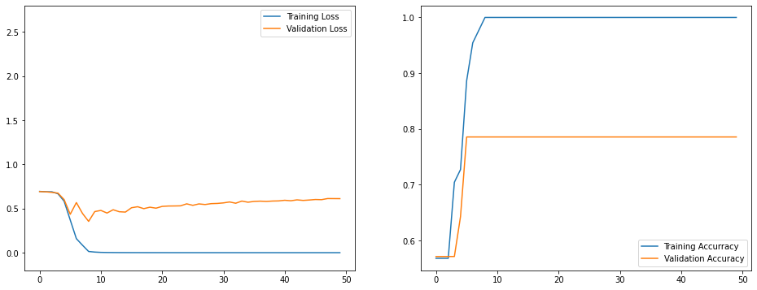
#Preprocessing function:
#Image Resized to 128x128 and scaled between [0,1]
if normalization>0:
#Contrast Limited Adaptive Histogram Equalization (CLAHE)
image_preproc=tf_clahe.clahe(image_preproc*255)/255
return image_preproc
#Case 1 No contrast normalization is performed
normalization=0
#Case 2 With Contrast Normalization
normalization=1
Binary cross entropy loss
No normalization
Not generalizing at all
Binary cross entropy loss
Normalization helps
Still significant overfitting
Notes:
Using the old model I’ve tested the 2 cases -> without normalization and with
And you can see the huge difference in performance.

Slide 14
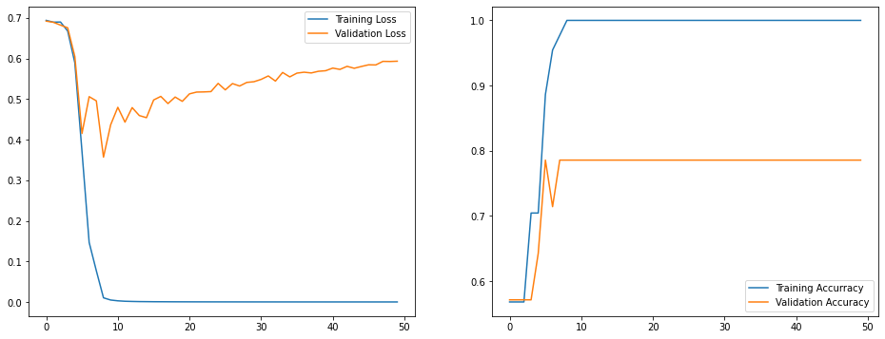
Early Stopping
Model gradually complexifies to better fit the training data.
However it generalizes less to the validation set.
We take the model which generalizes best i.e. with the best performance on the validation set.
Binary cross entropy loss
Simple and immediate improvement
No extra cost and can even reduce training time
Can be performed monitoring any metric
Best model
on validation set
X Might give overly optimistic validation metrics
Final model
Notes:
One of the things you can see is that actually the validation loss starts increasing the further you train your network.
This is a quite common phenomenon. The model will gradually complexify to better fit the training data.
However it generalizes less well as training continues.
One of the methods for preventing overfitting is called early stopping. And it consists in selecting the model with the best performance on the validation data (not seen during training) to have the model which generalizes best.
It comes at no extra cost and can actually be used with a criterion to actually stop training earlier.
And it can be performed using any metric you are monitoring.
One of the down side is that it might be overly optimistic on the validation set as you are choosing the best based on the validation dataset.

Slide 15
# Define callbacks (Here we save the model with the best accuracy on the validation set)
checkpoint_filepath = '/tmp/checkpoint'
model_checkpoint_callback = tf.keras.callbacks.ModelCheckpoint(filepath=checkpoint_filepath, save_weights_only=True, monitor='val_loss', save_best_only=True)
# Fit model to data
History = model.fit(train_data, train_labels,
validation_data=(val_data,val_labels),
callbacks=[model_checkpoint_callback],
batch_size=1,epochs=50, verbose=1,shuffle=True)
# Early stopping
model.load_weights(checkpoint_filepath)
Define callback -> minimum val_loss
Add to model fitting
Binary cross entropy loss
Load model
with ‘best’ weights
Best model
on validation set
Final model
Notes:
How do you implement this.
Keras has something called callbacks which are generally used to monitor or perform some actions during training.
Here we use the tf.keras.callbacks.ModelCheckpoint function which will save the best model according to the val_loss (but this could be accuracy for exemple) in the folder checkpoint_filepath.
We add this callback to the model.fit.
And when finished training you can reload the model with the “best” weights to reobtained the best trained model.

Slide 16
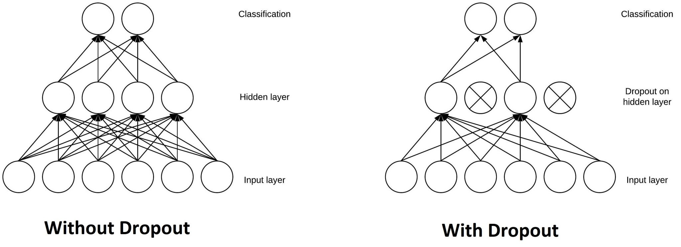
Drop out
Decrease dependence on any specific unit
More distributed weights to take a decision
X Longer to train (more noisy updates)
Notes:
As you could see there was still significant overfitting and we will need other techniques to further reduce that.
Drop out is a classical technique to reduce overfitting.
You can add drop-out layers.
The Dropout layer randomly sets input units to 0 with a frequency of rate at each step during training time which Decrease dependence on any specific feature
Leading to more distributed weights to take the final decision which helps prevent overfitting.
Note that the Dropout layer only applies when training but all weights are used during inference.
This can however lead to more noisy training as you are randomly removing features and longer training times.

Slide 17
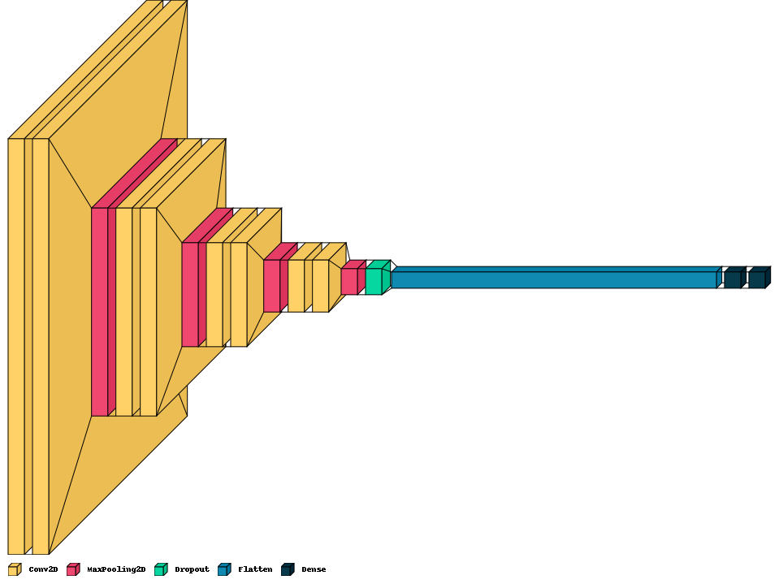
#CNN layers with maxpooling
for ii in range(nLayers):
model.add(tf.keras.layers.Conv2D(nConvFilters, kernel_size=(3, 3), padding='same', activation='relu'))
model.add(tf.keras.layers.MaxPooling2D(pool_size=(2, 2)))
#Add option of drop-out with rate dropout
if dropout_rate>0:
model.add(tf.keras.layers.Dropout(dropout_rate))
## Reduce to 1 dimension for classification
model.add(tf.keras.layers.Flatten())
Add a Dropout layer between the CNN and the Dense layers
Notes:
In terms of code
-> If we go back to the model creation.
We have this model where we add our layers one by one convolutions, maxpooling.
Then here we add a Dropout layer (with a given dropout rate in our exemple 30%) after the final CNN layers. This randomly drops 30% of the selected features before the dense network and probability estimation (during training only).

Slide 18
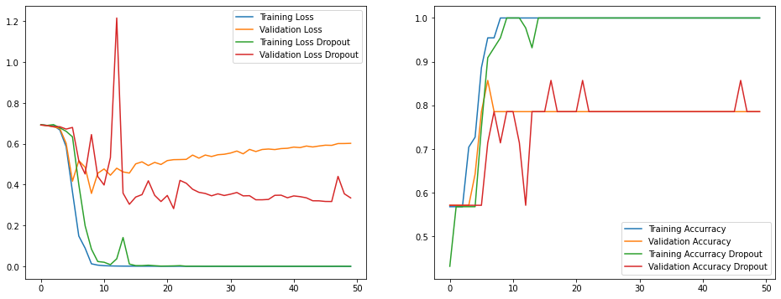
Binary cross entropy
Accuracy
Reduced overfitting
Epochs
Epochs
Notes:
We trained the model and we can see
The more noisy updates,
The slightly longer training
But an overall reduced overfitting and slight performance improvement so a simple single dropout layer seems to have helped significantly.
Although this is not yet fully satisfying.

Slide 19
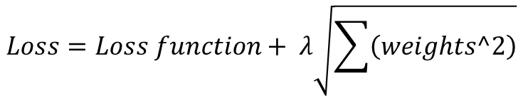
Weight regularization
Large weights in a neural network are a sign of a more complex network that has overfit the training data.
Penalizing a network based on the size of the network weights during training can reduce overfitting.
$$Loss=Loss function+ λ\sqrt{\sum{\left(weights^2\right)}}$$
Additional L2 (or L1 or L1L2) Penalty on the weights of the network
Similar effects to drop-out
Decrease dependence on any specific unit
More distributed weights to take a decision
X Tuning the regularization parameter
X Over regularization will lead to suboptimal results
Notes:
Drop out is a classical technique to reduce overfitting.
The Dropout layer randomly sets input units to 0 with a frequency of rate at each step during training time, which helps prevent overfitting. Inputs not set to 0 are scaled up by 1/(1 - rate) such that the sum over all inputs is unchanged.
Note that the Dropout layer only applies when training is set to True such that no values are dropped during inference.

Slide 20
# Add L2 regularization if kernel_regularizer is not None
if lambda_regularizer is not None:
kernel_regularizer=tf.keras.regularizers.l2(lambda_regularizer)
#CNN layers with maxpooling
for ii in range(nLayers):
model.add(tf.keras.layers.Conv2D(nConvFilters, kernel_size=(3, 3), padding='same’, activation='relu’, kernel_regularizer=kernel_regularizer))
model.add(tf.keras.layers.MaxPooling2D(pool_size=(2, 2)))
Add regularization to all layers with trainable weights

Slide 21
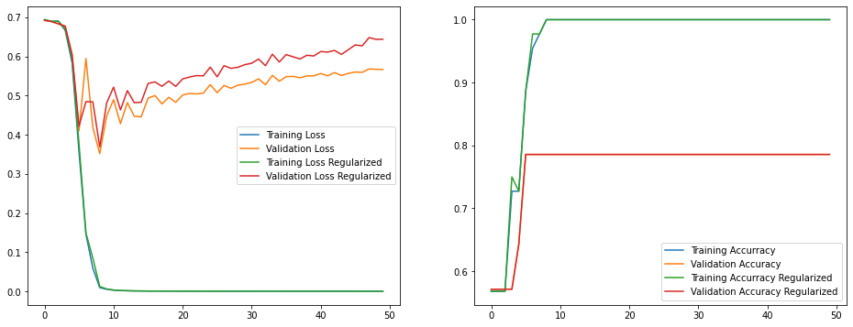
Binary cross entropy
Accuracy
Validation error increased
No improvement in accuracy
Epochs
Epochs

Slide 22
Data augmentation
SAX
SAX
SAX
Artificially increase the size of the dataset
Lower cost than acquiring more data
X Usually not as good as more collected data
X The network now needs to be able to classify an image in any orientation.
Notes:
The accuracy of deep learning models largely depends on the quality, quantity, and contextual meaning of training data.
Data scarcity or label scarcity can be mitigated through the use of data augmentation.
With the same image and label you can create a large number of different data, with changes in contrast, scale and noise level for exemple without changing the fact that this image is obviously a Short axis image.
To the network these are different images which they should all classify correctly.
This enables to artificially increase the dataset size without the extra costs of collecting it. However biases from the original data ight persist through data orientation so it is usually not as good as actually collecting more data.
In our case the task becomes slightly different as the network now needs to be able to classify data in any orientation and not the clinically acquired one.

Slide 23
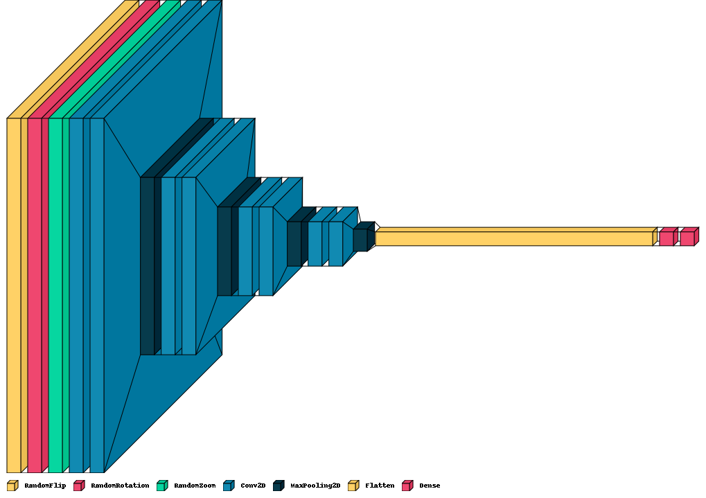
#Data augmentation option
if augment>0:
model.add(tf.keras.layers.RandomFlip("horizontal",input_shape=input_shape ))
model.add(tf.keras.layers.RandomRotation(0.3))
model.add(tf.keras.layers.RandomZoom(0.2))
#Create rest of the model
Add transformation layers

Slide 24
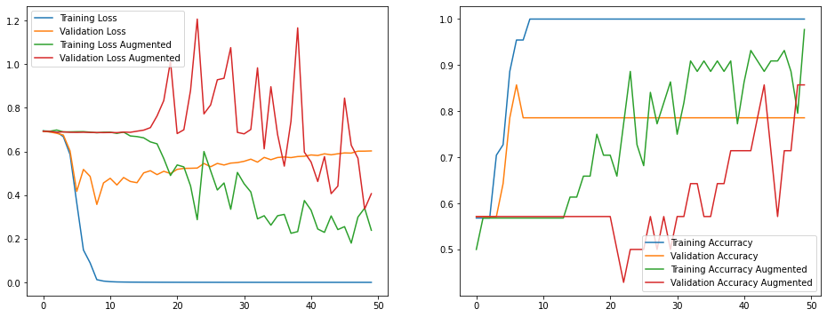
Improved performance
Binary cross entropy
Accuracy
Reduced overfitting
Epochs
Probably can train longer
Epochs

Slide 25
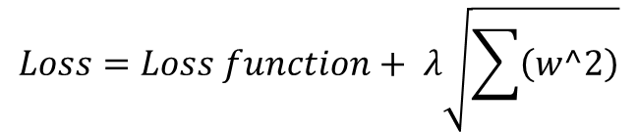
Combining methods
$$Loss=Loss function+ λ\sqrt{\sum{\left(w^2\right)}}$$
SAX
SAX
SAX
These methods can be combined

Slide 26
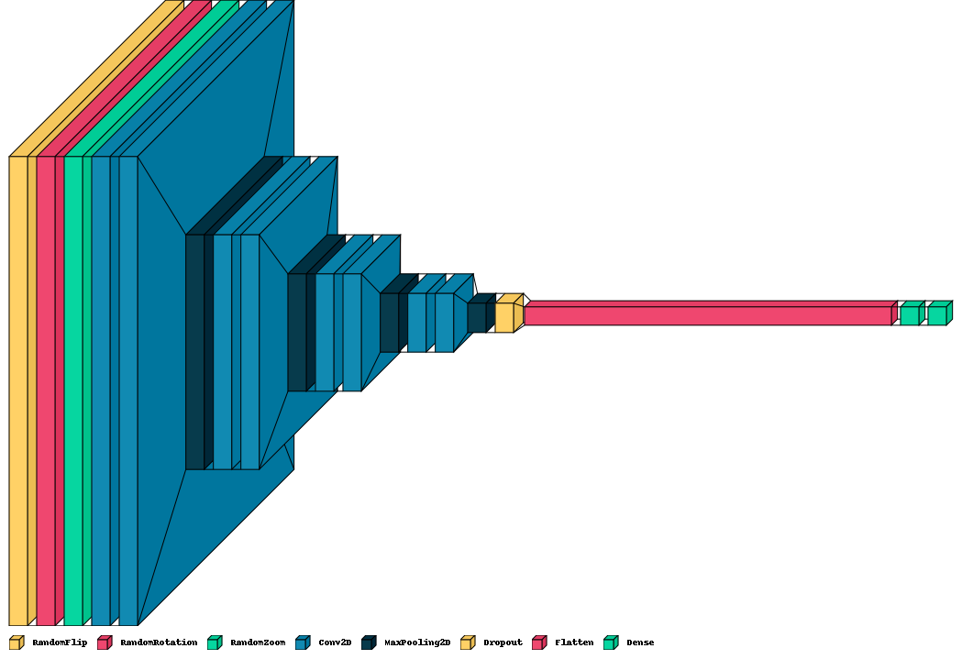
#Create model Final Model
model=create_new_model(train_data, augment=1, dropout=0.3, kernel_regularizer=0.0001)
Add regularization to all layers with trainable weights
Add Dropout
Add transformation layers

Slide 27
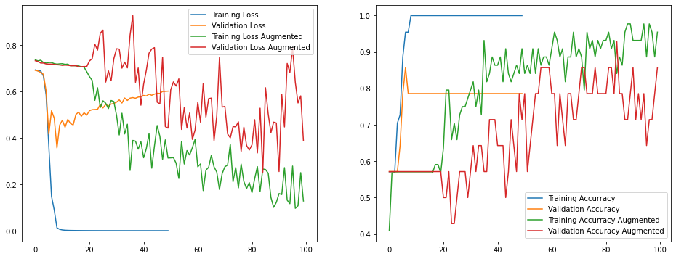
Binary cross entropy
Accuracy
Improved performance
Epochs
Epochs
Trained Longer

Slide 28
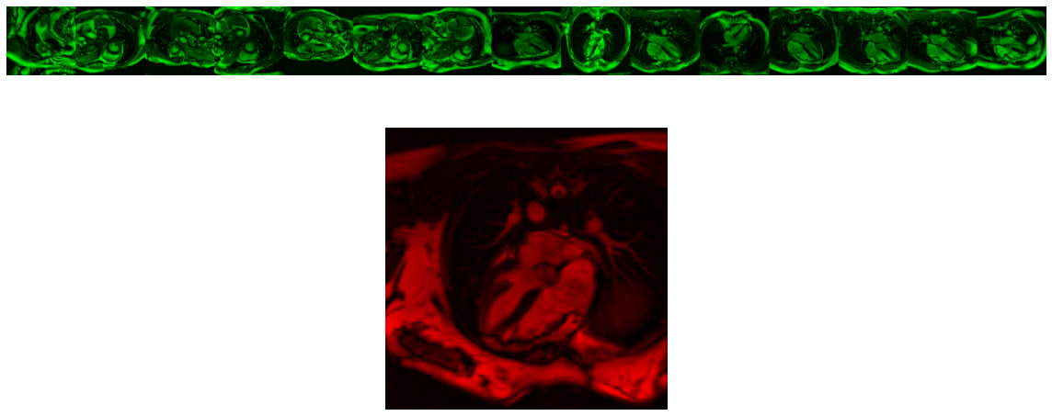
testeval = model.evaluate(test_data,test_labels)
1/1 [==============================] - 1s 1s/step - loss: 0.2276 - accuracy: 0.9375

Slide 29
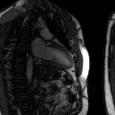
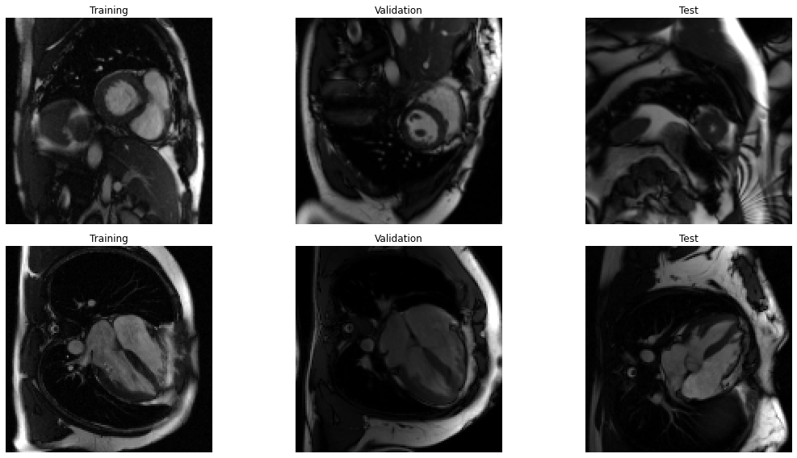

Extending to multi class
SAX
LAX
4CH
Label hot encoding :
[1 0 0]
[0 1 0]
[0 0 1]
Loss: Categorical cross entropy (i=3)
Output activation: Softmax
(outputs probabilities adding up to 1)
[0.2 0.72 0.08]
Notes:
Just to give you the feeling for tackling a multi class problem.
It is actually pretty simple to jump from 2 to multiple classes.
If we take our exemple and aim at classifying in 3 different orientations we need 3 modifications -> The labelling (hot encoding the different class)
Loss to categorical cross entropy
And output layer to softmax activation with 3 outputs.

Slide 30
At Label Creation
## Labels [1 0 0] if SAX, [0 1 0] if LAX, [0 0 1] if 4CH
Modify output labels
At Model Creation
## Fully connected to combine all features
model.add(tf.keras.layers.Dense(nInitConvFilters*2**(ii+1),activation='relu',kernel_regularizer=kernel_regularizer))
## Multi Class Regression
model.add(tf.keras.layers.Dense(number_classes, activation= tf.keras.activations.softmax))
Modify the last layer’s activation function and number of outputs
At Model compilation
# Compile the model
model.compile(loss=tf.keras.losses.CategoricalCrossentropy, optimizer=tf.keras.optimizers.Adam(0.0001), metrics=['accuracy'])
Change the loss when compiling the model
Notes:
In terms of code:
So this wasn’t tested as we don’t have enough data for the different orientations.
But in principal as I said you would only need to modify the data (labels).
The last layer at model creation -> number of outputs, and activation function from sigmoid to softmax
And change the loss at model compilation.

Slide 31
Applications in CMR
Notes:
Ok now that’s about it for the theory.
I just wanted to show a few potential applications which are hopefully a bit more exciting than classifying the orientation of images.

Slide 32
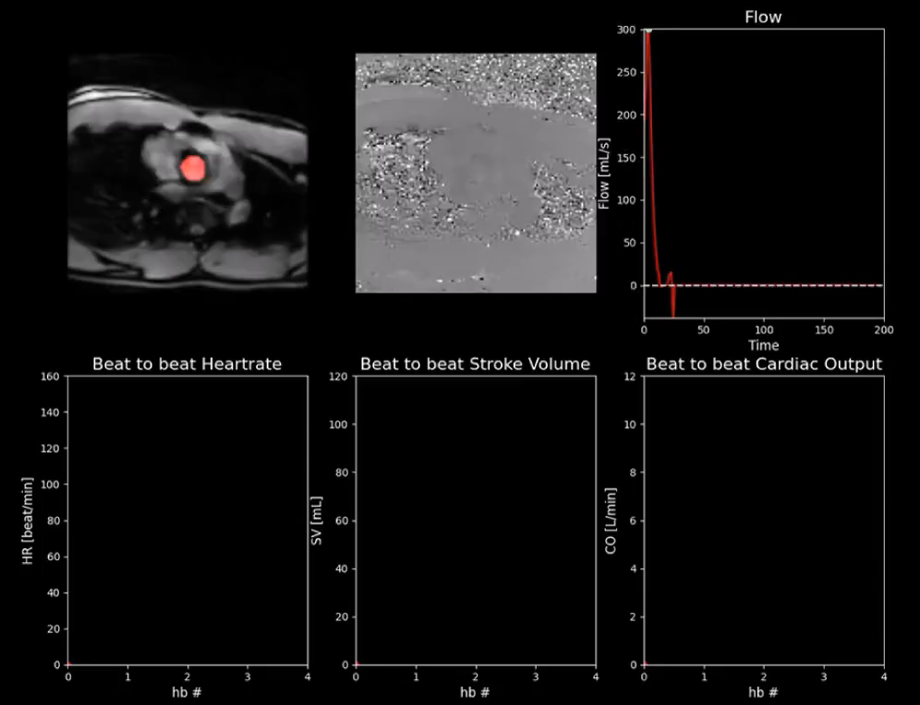
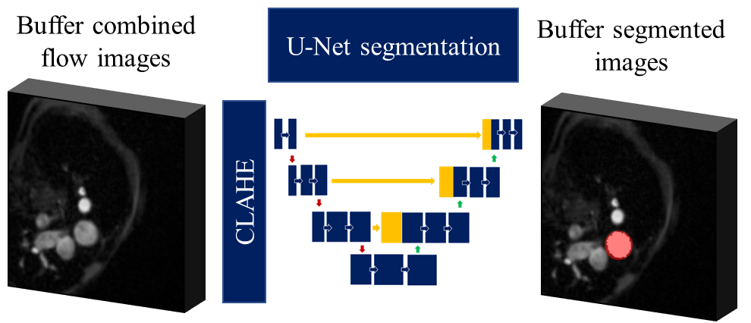
Application to segmentation: Pixel to pixel classification
Image to Image
SCMR Series of Hands-on Workshops on Machine Learning
A Segmentation Task in CHD
October 26th, 2022 • 17:00 BST Dr Saeed Karimi-Bidhendi
Notes:
So I think the most used application of classification in CMR is segmentation -> Which can be considered as a pixel to pixel classification
here I show an exemple of mine where we segment the aorta of flow images in real time during exercise to provide metrics such as Cardiac output and stroke volume.
We use deep learning to obtain these hundreds and hundreds of segmentations with high speed enabling new applications in CMR.
I won’t talk too much more about segmentation as it is the main topic of next month.
The session will be taught by Dr Saeed Karimi-Budhendi. Do sign on if interested.

Slide 33
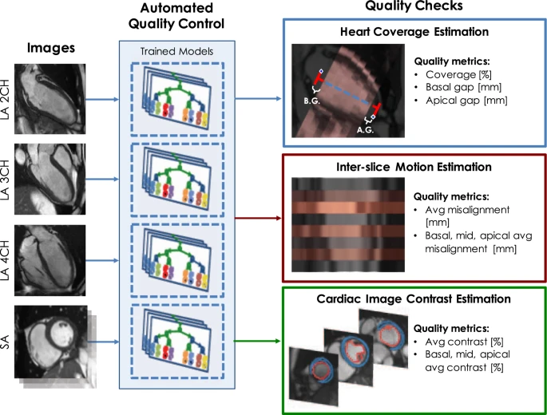
Application to Large Scale Quality Control: Large-scale Quality Control of Cardiac Imaging in Population Studies
Tarroni, G., Bai, W., Oktay, O. et al. Large-scale Quality Control of Cardiac Imaging in Population Studies: Application to UK Biobank. Sci Rep 10, 2408 (2020).
Notes:
Another cool application of deep learning is about automating tasks hard to automate before.
Being fast it can be applied to large scale datasets and here they use networks for landmark detection and segmentation to give a quality score for each CMR examination in the UK biobank dataset.
This can then be used to clean datasets, review uncertain cases, reacquire certain images etc.

Slide 34
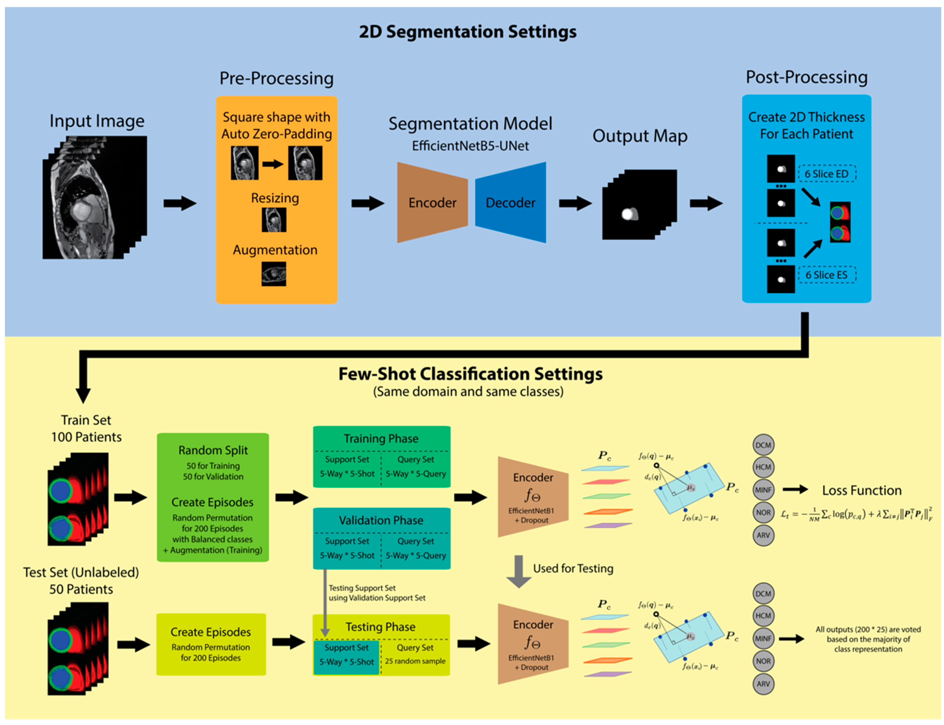
Disease classification:
Wibowo, A. Cardiac Disease Classification Using Two-Dimensional Thickness and Few-Shot Learning Based on Magnetic Resonance Imaging Image Segmentation. J. Imaging 2022
Notes:
Finally it can be useful for classifying cardiac diseases.
Here they use both segmentation and classification to guide and determine between different classical cardiac disease -> with quite nice accuracy 92%.
The idea is that it could be a nice tool to guide and help in clinical decisions.

Slide 35
Conclusion
Hopefully this gives you
A better understanding of classical methods for dealing with overfitting
Ways to improve the generalizability of your models
An idea of the potential of machine learning approaches for CMR
The tutorials and data as well as the video of this talk will be available on the github repository.

Slide 36


Thank you for your attention!
Javier Montalt-Tordera
Rebecca Baker
Michele Pascale
Sheena Bhagirath
Saeed Karimi-Bidhendi
Dan Knight
Vivek Muthurangu
Jennifer Steeden

